Slide 2
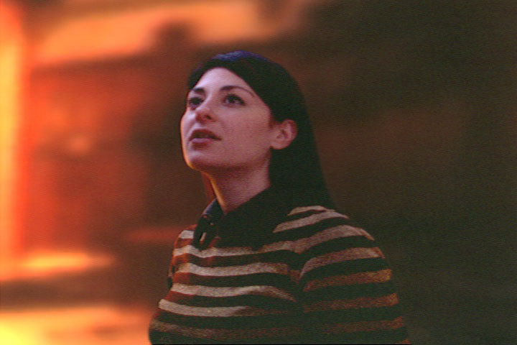
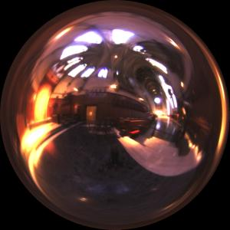
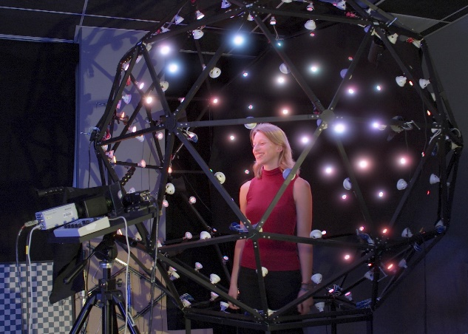
A Lighting Reproduction Approach to Live-Action Compositing
Paul Debevec Andreas Wenger Chris Tchou Andrew Gardner Jamie Waese Tim Hawkins
USC Institute for Creative Technologies

Slide 3
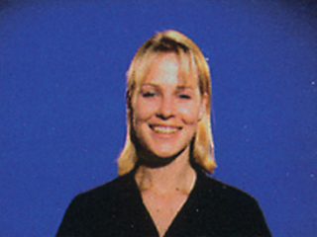
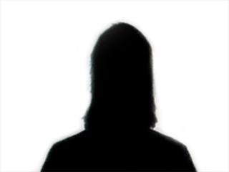
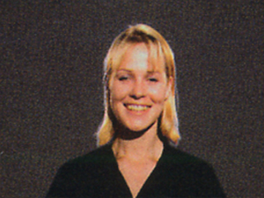
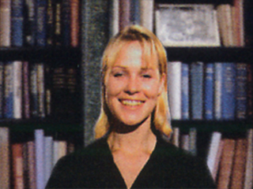
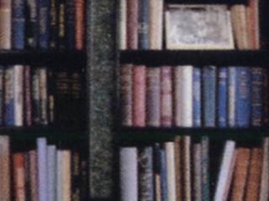
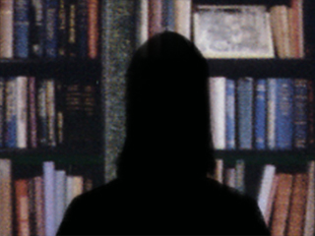
Traditional Live-Action Compositing
Images: BKSTS film process chart

Slide 4
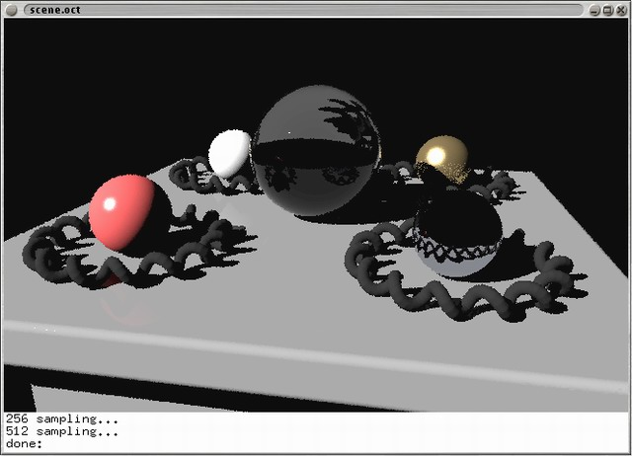

Slide 5
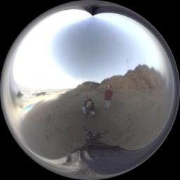
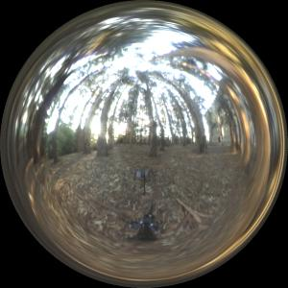
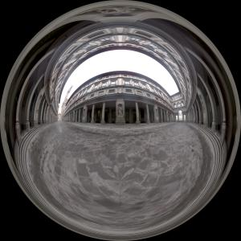
Real-World HDR Lighting Environments
Funston Beach
Eucalyptus Grove
Uffizi Gallery
Grace Cathedral
Lighting Environments from Debevec98: http://www.debevec.org/Probes/

Slide 6
Illuminating Objects using Measurements of Real Light
Environment assigned “glow” material property in Greg Ward’s RADIANCE system.
Light
Object
http://radsite.lbl.gov/radiance/

Slide 7
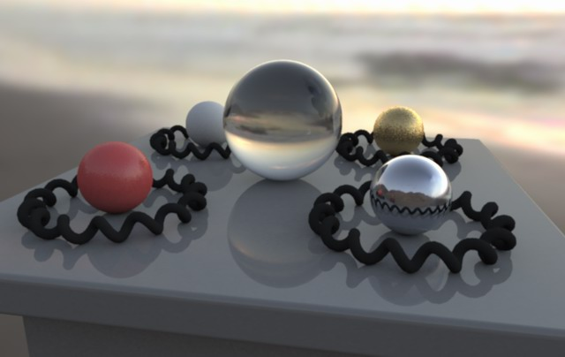
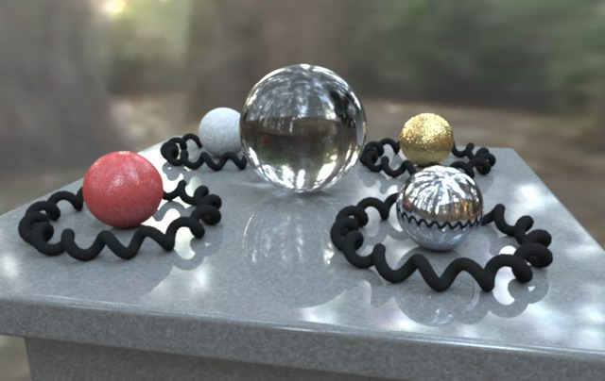
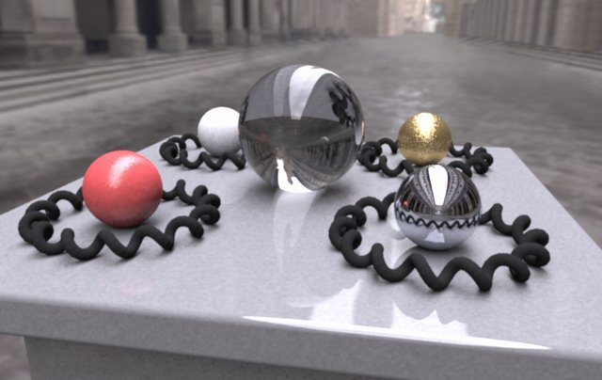
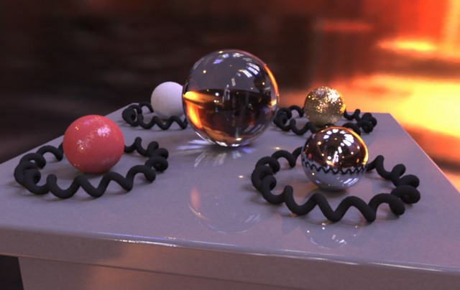
Paul Debevec. A Tutorial on Image-Based Lighting. IEEE Computer Graphics and Applications. Special Issue on IMBR, Jan/Feb 2002.

Slide 9
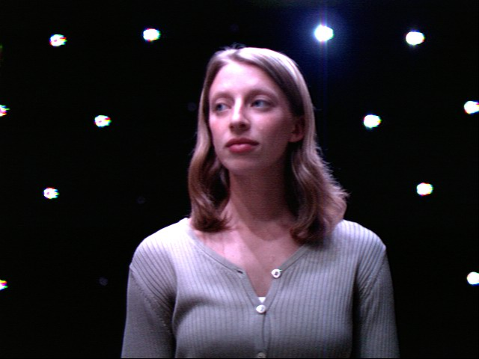
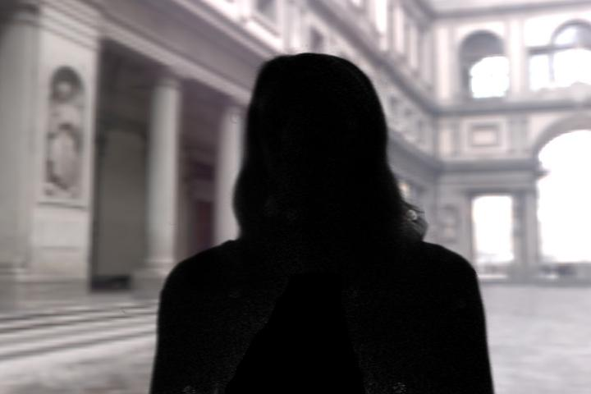
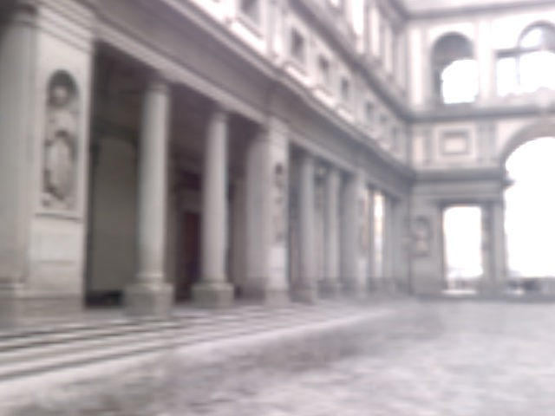
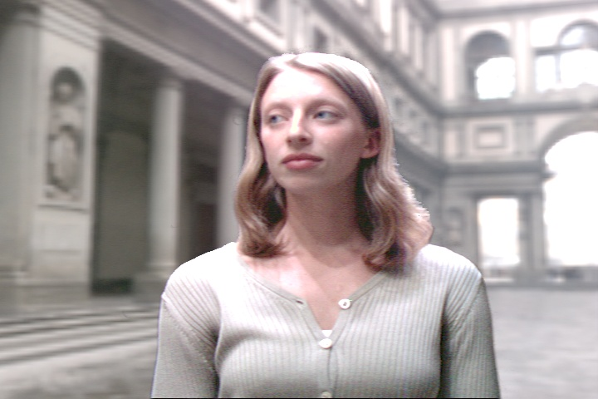
A Lighting Reproduction Approach

Slide 10
Related Work
Blue Screen Matting Smith and Blinn 96 Chuang et al. 02 (Video Matting)
Recombining basis lighting Debevec et al. 00 (Light Stage 1) Hawkins et al. 01 (Light Stage 2) Malzbender et al. 01 (PTMs) Koudelka et al. 01
Environment Matting Zongker et al. 99 Chuang et al. 00 (Real time!)

Slide 11
www.desertdomes.com

Slide 12
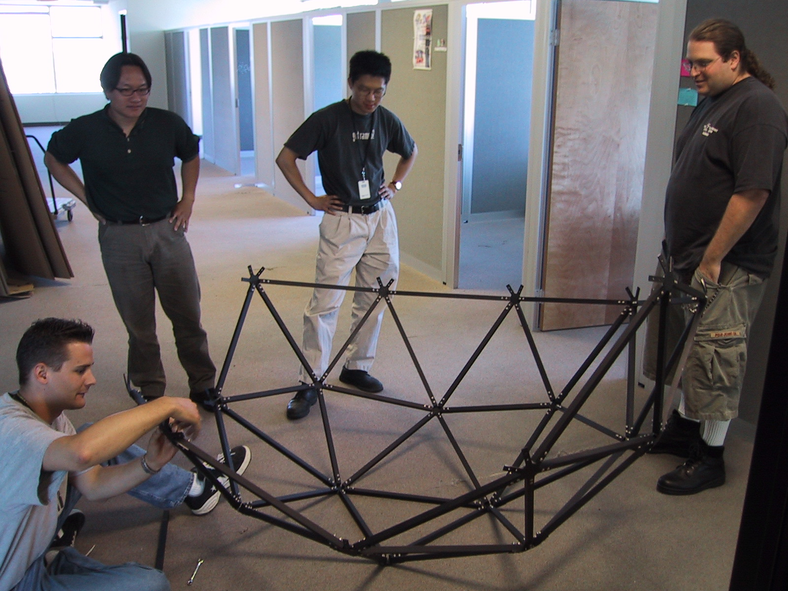

Slide 13
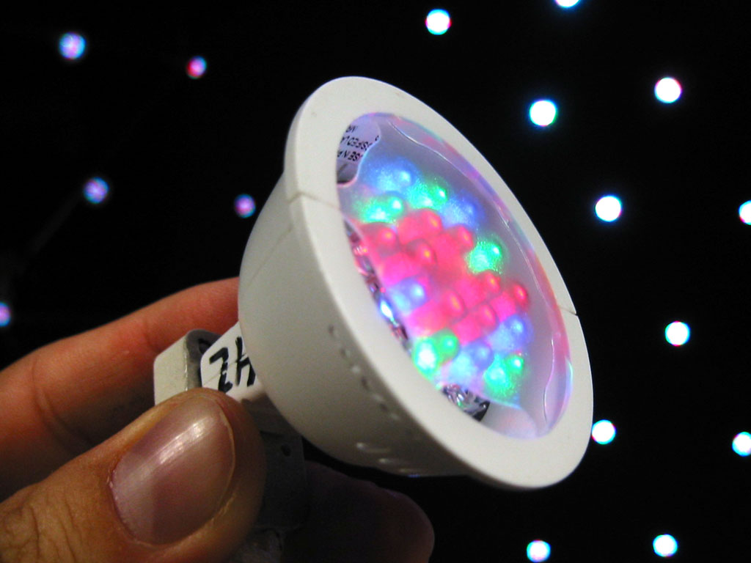
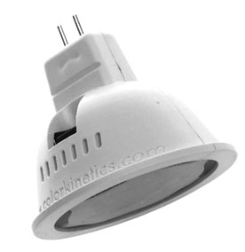
Color Kinetics iColor MR Light
18 LEDs: 8 Red, 5 Green, 5 Blue
USB Addressable, 8-bit RGB values
www.colorkinetics.com

Slide 14
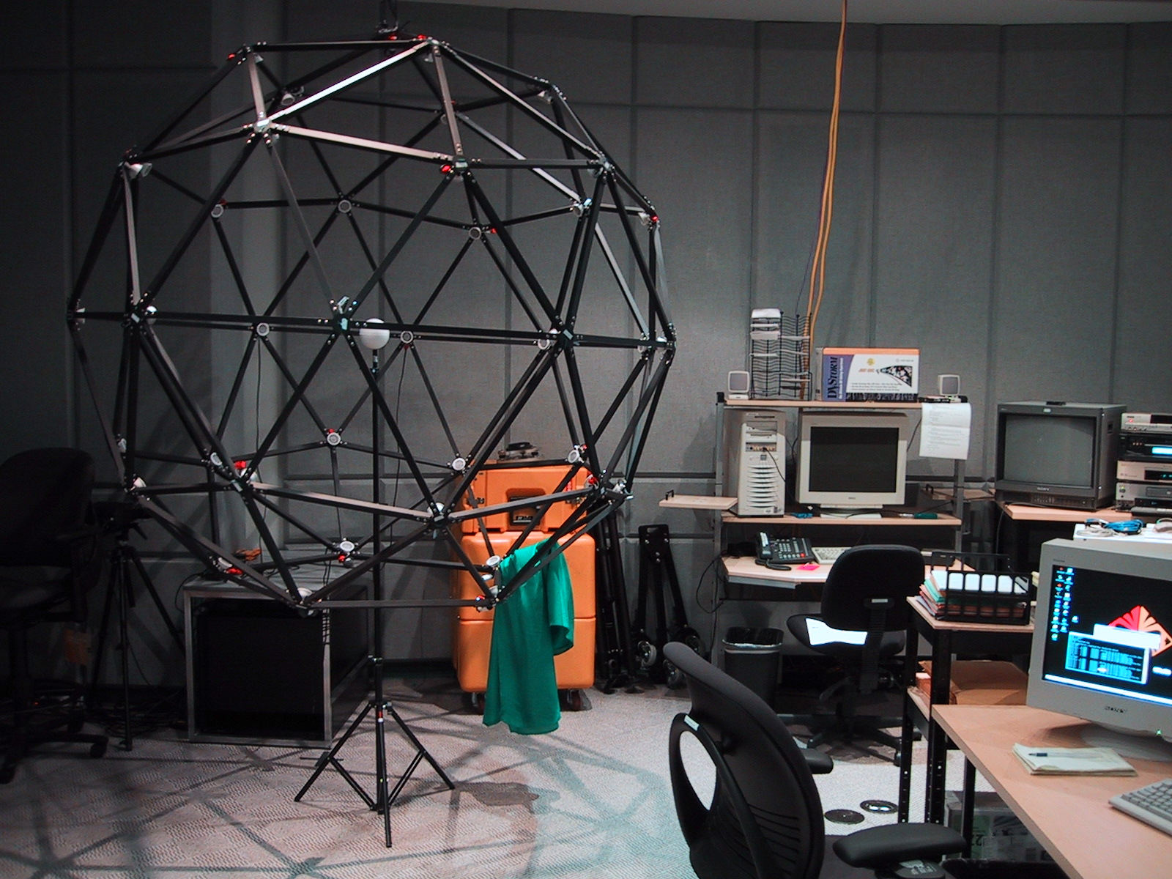

Slide 15
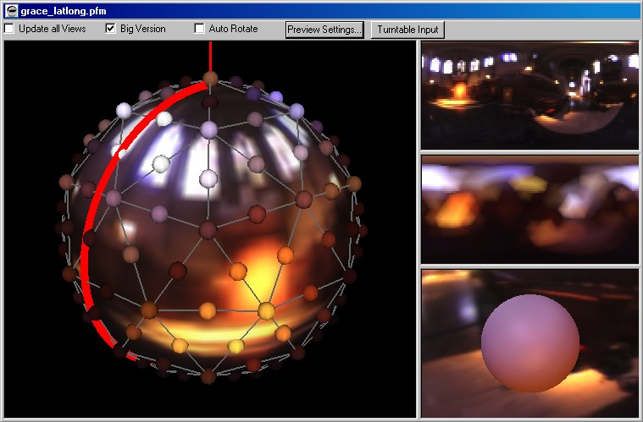
Light Stage 3 Control Program

Slide 16
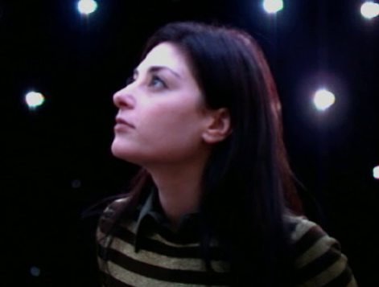
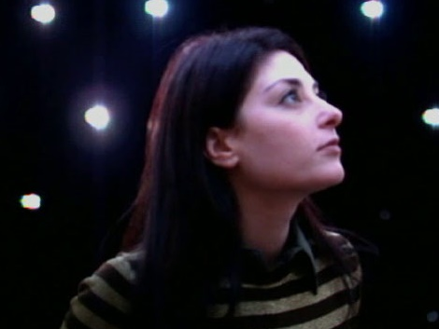
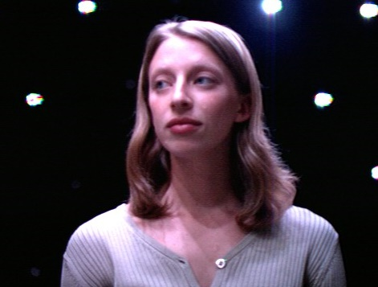
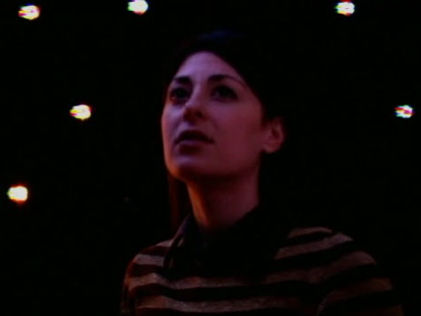
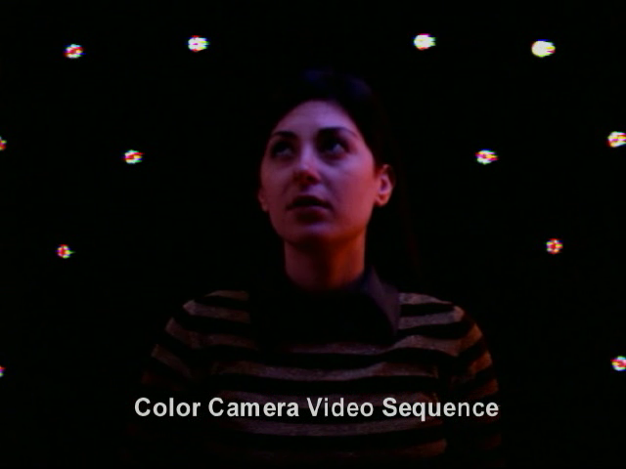
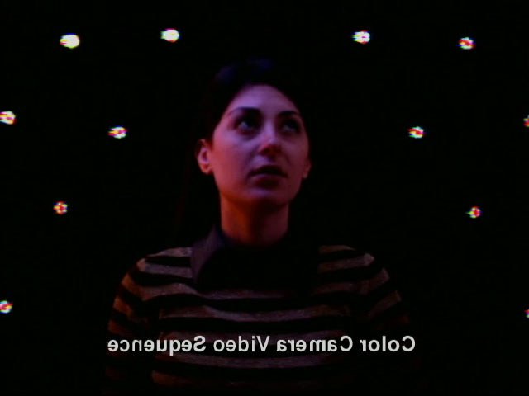
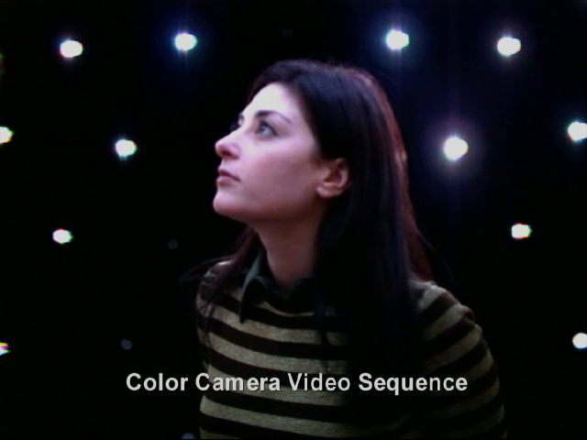
Illuminated Actors

Slide 17
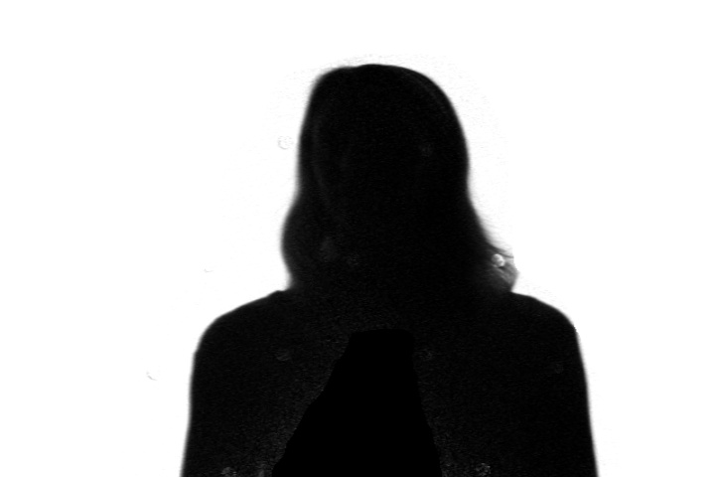
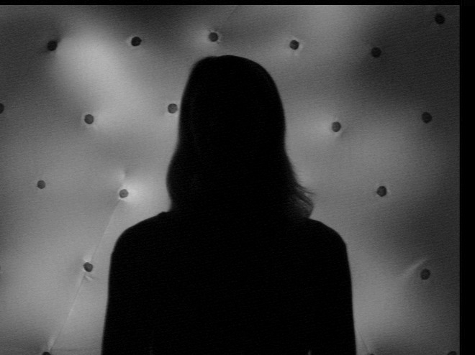
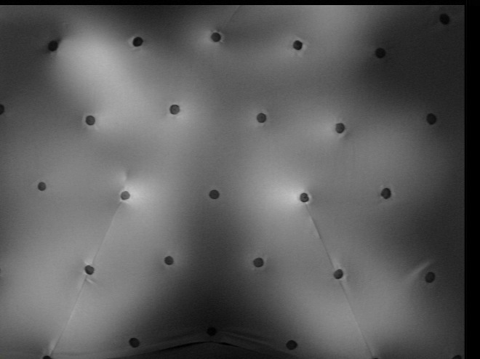
Obtaining a Matte

Slide 18
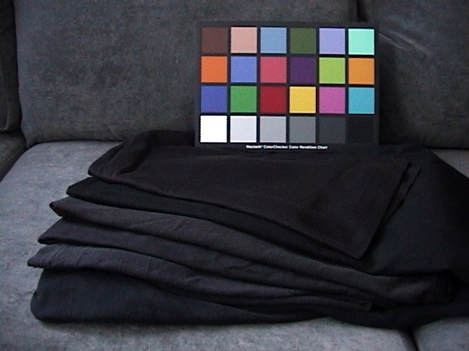

Slide 19
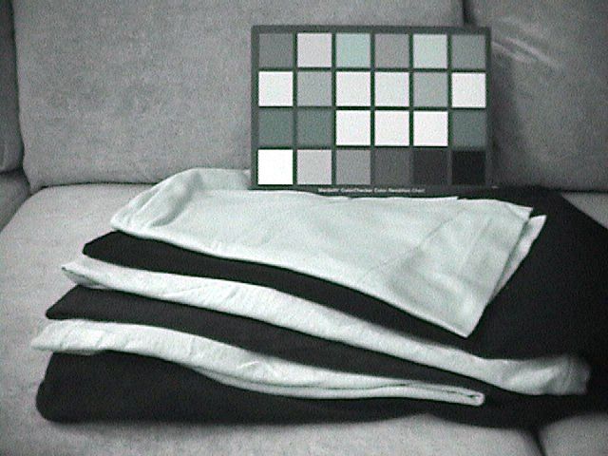

Slide 20
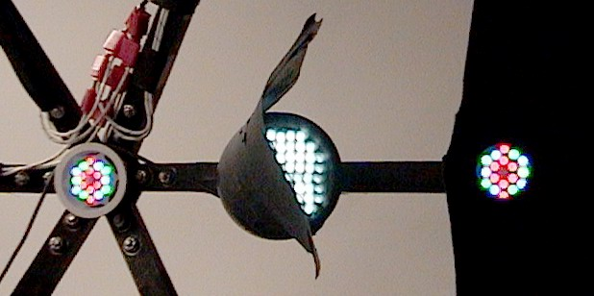
Infrared LED IR-Screen Lights

Slide 21
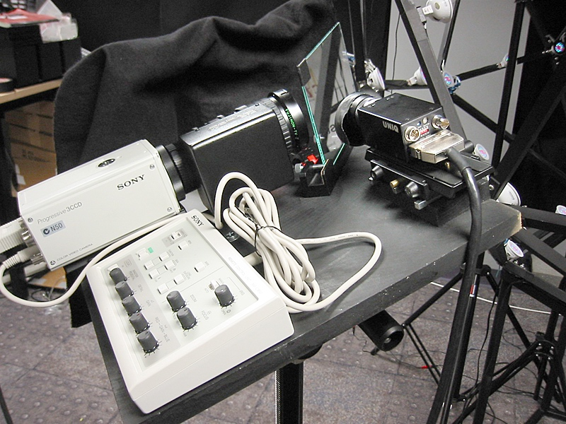
LS3 Camera System
Beam Splitter
Infrared Camera
Color Camera

Slide 22
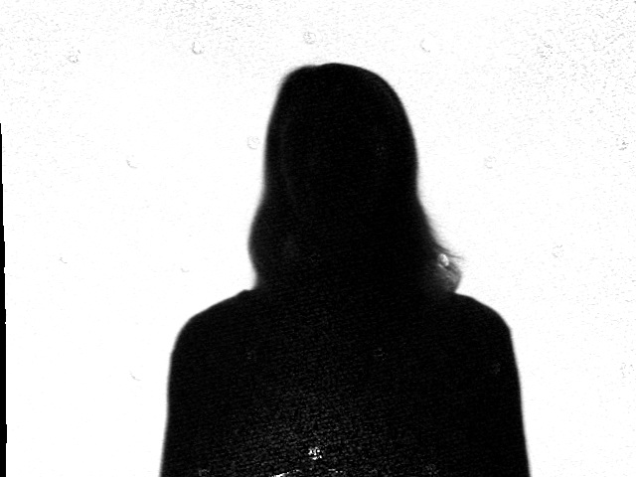
Matte Division

Slide 23
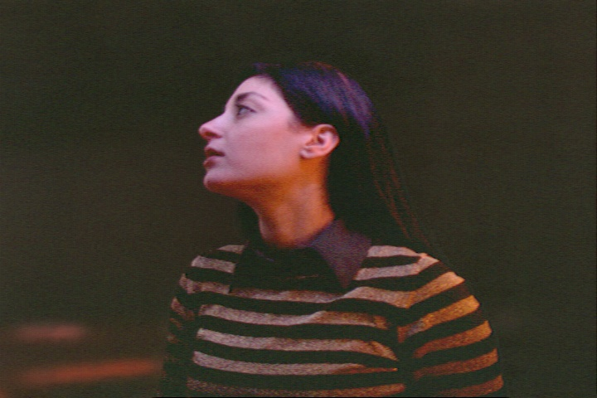
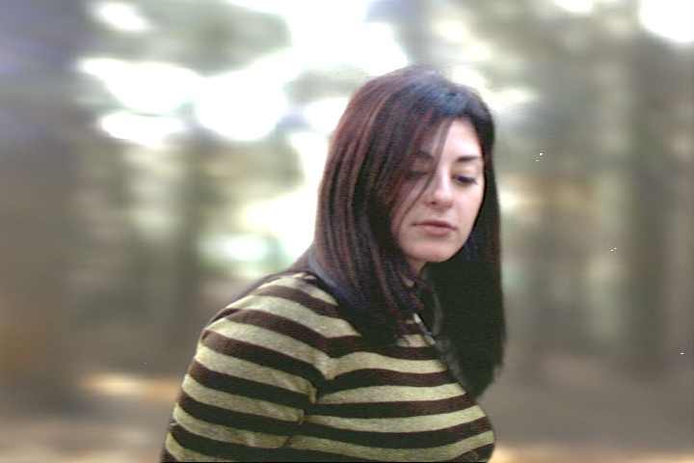
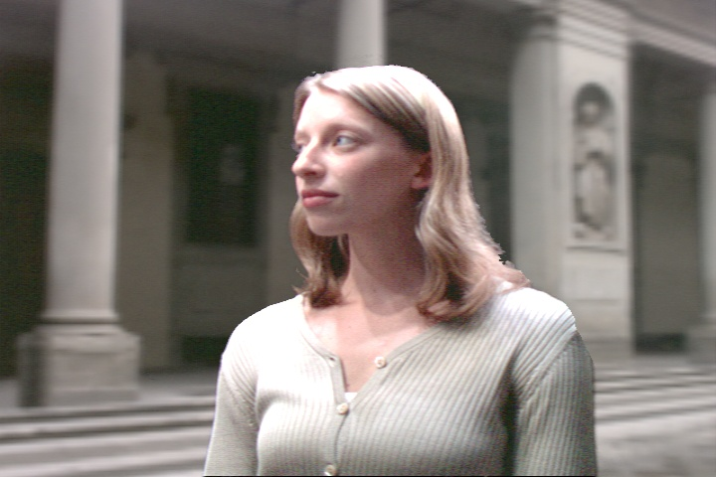
Composited Results

Slide 24
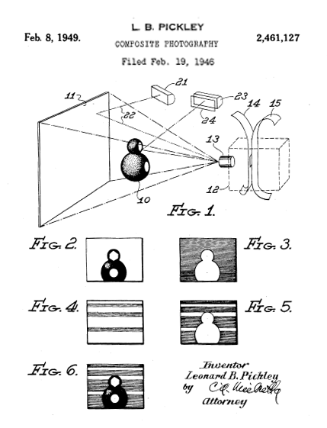
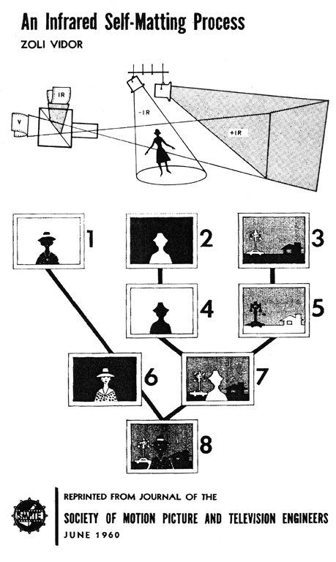
“An Infrared Self-Matting Process” Z. Vidor JSMPTE 1960
“Composite Photography” L. B. Pickley USPTO 1949
Research thanks: Johnathan Banta, Ken Wiatrak

Slide 25
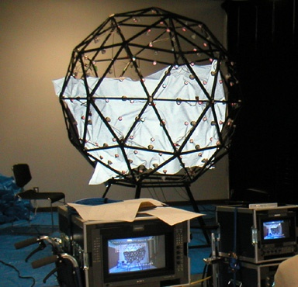
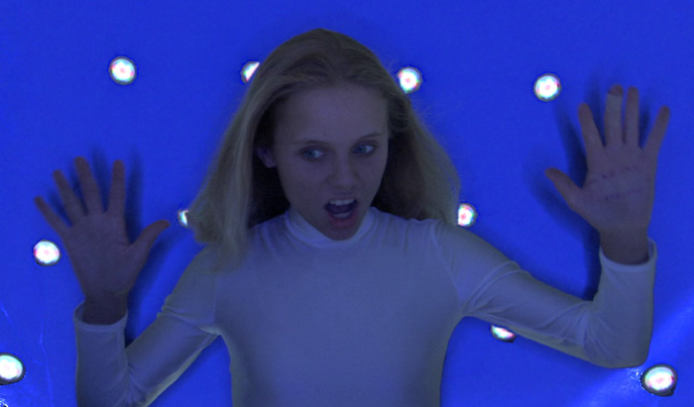
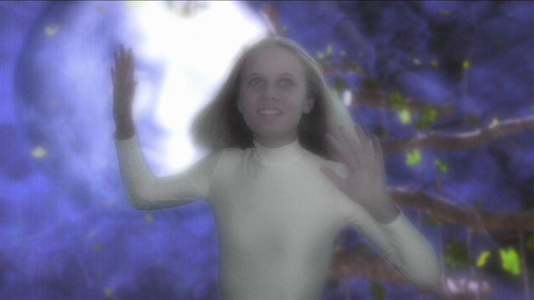
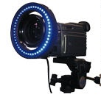
Front-Projection Blue Screen
Used at Keio University for “The Magick Lesson” Directed by Mark Dippe and Masa Inakage

Slide 26
iColor MR Response Curve
Calibrated using Photo Research PR650 Spectroradiometer http://www.photoresearch.com/

Slide 27
Sony DXC-9000 Response Curve
Calibrated using HDR Shop: http://www.debevec.org/HDRShop/

Slide 28
Center of Projection Calibration
IR Camera:17mm
Color Camera: 55mm

Slide 29
Beam Splitter
Infrared Camera
Color Camera

Slide 30
Color/IR Image Registration
Color Image
IR Image

Slide 31
Color Image

Slide 32
IR Image

Slide 33
Corner-detected IR Image

Slide 34
Corner-detected Color Image

Slide 35
Warping Grid

Slide 36
IR Image - warped

Slide 37
Color Image

Slide 38
Unwarped Matte

Slide 39
Warped Matte

Slide 40
Foreground

Slide 41
Plate with matte holdback

Slide 42
Final Composite

Slide 43
Color Calibration
Falloff Compensation
L
ρ_{d}=1
R
L’ = MR

Slide 44
3D Virtual Set
Rendered with Global Illumination and Image-Based HDR Lighting in “Arnold” by Marcos Fajardo

Slide 45
Virtual Set Composite with Dynamic Lighting

Slide 46
Future Work
Reproduce near-field incident illumination
Video Projectors
Add artistic controls
Rim Lights
Bounce cards
More and Brighter Lights
Larger Stage

Slide 47
Light Stage 4

Slide 48
Light Stage 4

Slide 49
Credits
Video Producer: Diane Piepol
Editing and Animation: Brian Emerson
Textures and Illustrations: Marc Brownlow
3D Virtual Set: Brian Emerson, Yikuong Chen, Rippling Tsou, Shivani Khanna, Diane Suzuki
Arnold Global Illumination Renderer: Marcos Fajardo
Infrared Matte Backing: Maya Martinez
Actors: Elana Livneh and Emily DeGroot
Consultants: Alex Singer, Randal Kleiser, Woody Omens, ASC, Gordie Haakstad, Kelly Richard, Andy Lesniak, Ken Wiatrak, and Ayten Durukan
Special Thanks: Dick Lindheim, Bill Swartout, Mike Andrews, Mike Macedonia, James Blake, Jacki Morie, Van Phan, Anshul Panday, Bobbie Halliday, Kevin Dowling, Andy van Dam, and Linda Miller, STRICOM, and Color Kinetics, Inc.
Sponsored by the United States Army, the University of Southern California, and TOPPAN Printing Co., Ltd.

